Slide 1
STORAGE DEVICES WE USE EVERYDAY
Presented by Vasilisa Efimova

Slide 2
Definition
Types of storage devices
Primary storage device
Secondary storage device
Examples of computer storage
Magnetic storage devices
Optical storage devices
Flash memory devices
Online and cloud
Paper storage
What is a storage location?

Slide 3
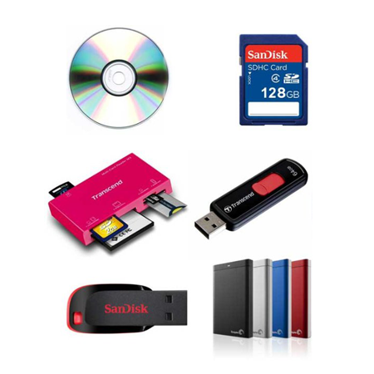
Storage device -
a piece of computer equipment in which information and instructions can be kept

Slide 4
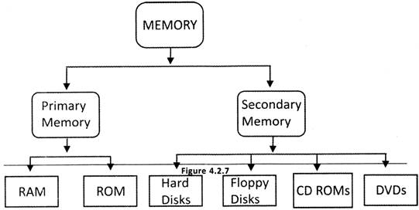
Types of storage devices

Slide 5
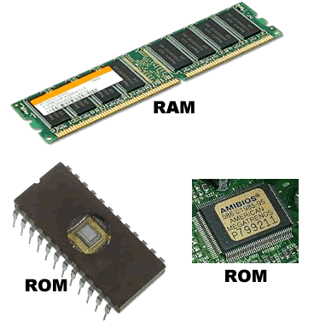
Types of storage devices
Primary storage device
quite smaller in size
designed to capture or hold data for a temporary period
inside the computer
the fastest access to data
examples: Cache memory and RAM.

Slide 6
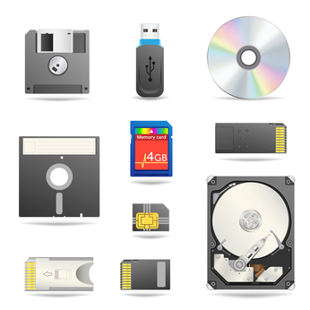
Types of storage devices
Secondary storage device
larger storage capacity
can store data permanently
can be both external and internal to a computer
examles: compact disk, USB drive, hard disk, etc.
Notes:
A secondary storage device has a larger storage capacity and can store data permanently. The device can be both external and internal to a computer and includes; compact disk, USB drive, hard disk, etc.
A primary storage device is quite smaller in size and it’s designed to capture or hold data for a temporary period. Most primary storage devices are found inside the computer, and they have the fastest access to data. Examples of Primary devices include Cache memory and RAM.

Slide 7
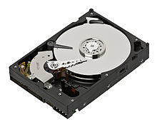
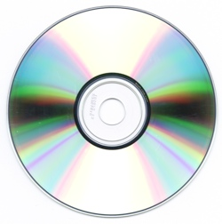
Examples of computer storage
Magnetic storage devices
Optical storage devices
Flash memory devices
Online and cloud
Paper storage

Slide 8
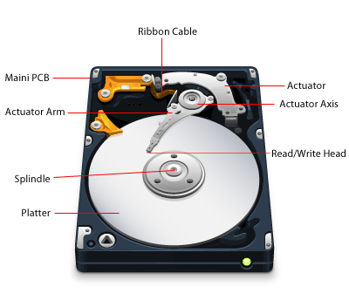
Magnetic storage devices
Floppy diskette
Hard drive
Magnetic strip
SuperDisk
Tape cassette
Zip diskette
Notes:
Today, magnetic storage is one of the most common types of storage used with computers. This technology found mostly on extremely large HDDs or hybrid hard drives.

Slide 9
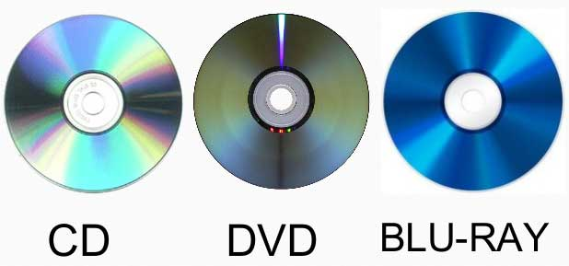
Optical storage devices
Blu-ray disc
CD-ROM disc
CD-R and CD-RW disc.
DVD-R, DVD+R, DVD-RW, and DVD+RW disc.
Notes:
Another common storage is optical storage, which uses lasers and lights as its method of reading and writing data.

Slide 10
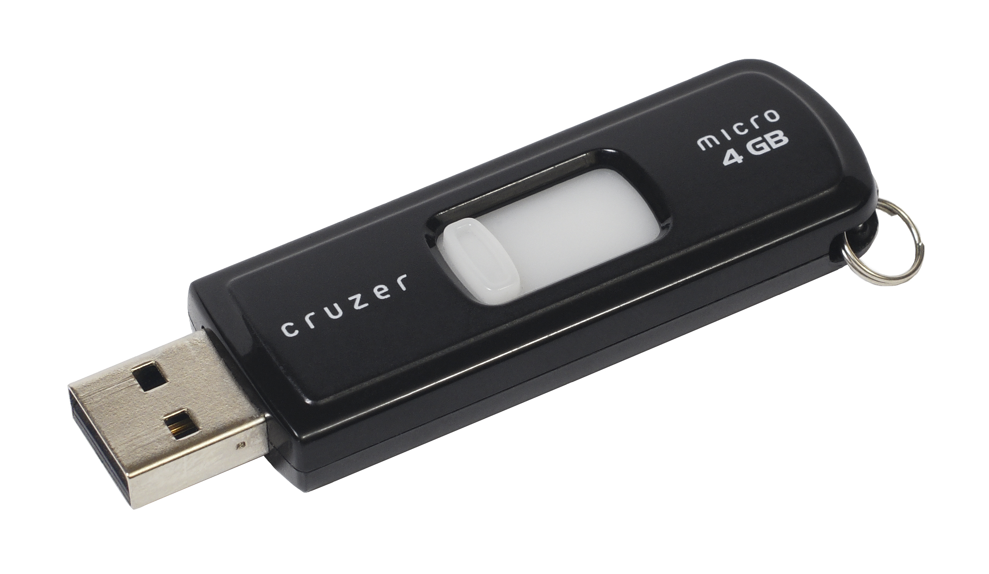
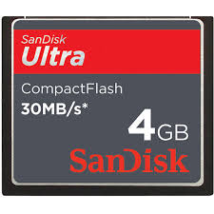
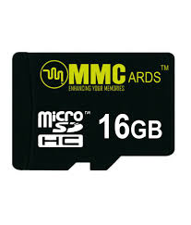
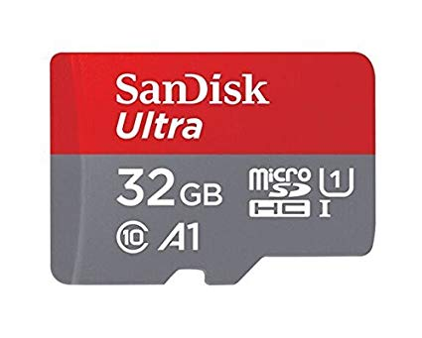
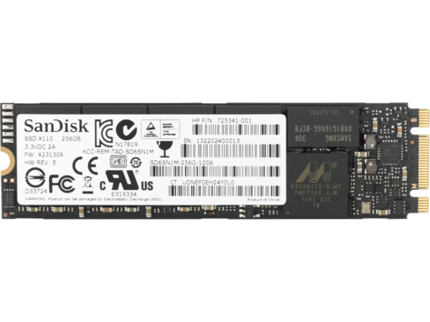
Flash memory devices
USB flash drive, jump drive, or thumb drive.
CF (CompactFlash)
Memory card
MMC
NVMe
Notes:
Flash memory has replaced most magnetic and optical media as it becomes cheaper because it is the more efficient and reliable solution.

Slide 11
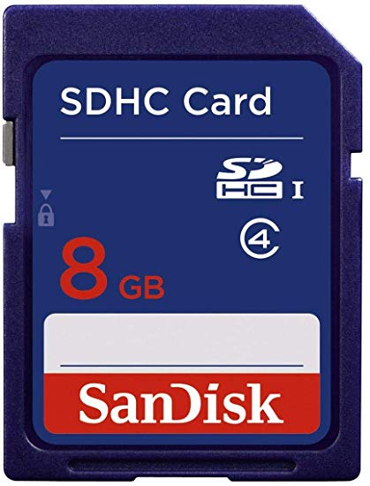
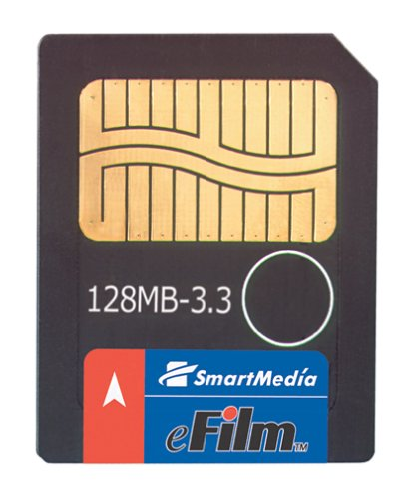
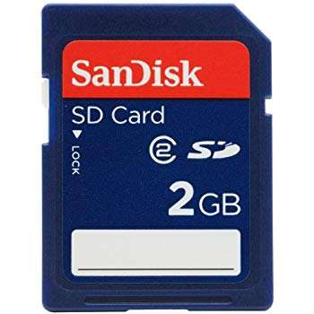
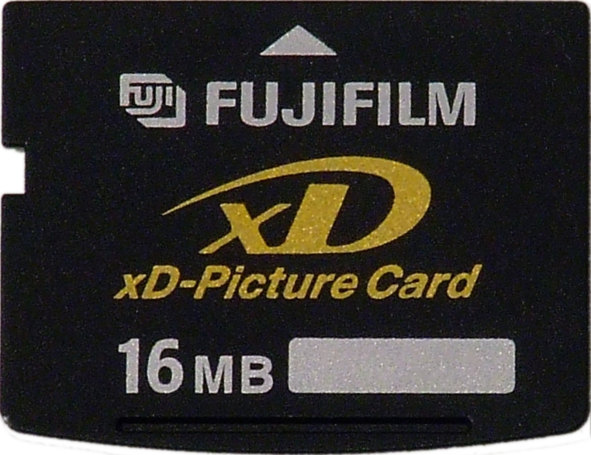
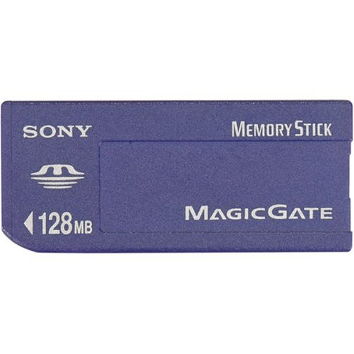
Flash memory devices
SDHC Card
SmartMedia Card
Sony Memory Stick
SD card
SSD
xD-Picture Card

Slide 12

Online and cloud
Cloud storage
Network media
Notes:
Storing data online and in cloud storage is becoming popular as people need to access their data from more than one device.

Slide 13
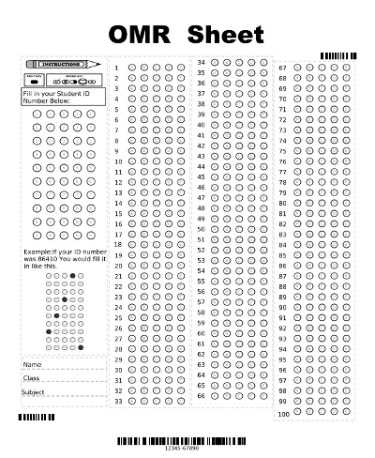
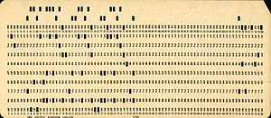
Paper storage
OMR
Punch card

Slide 14
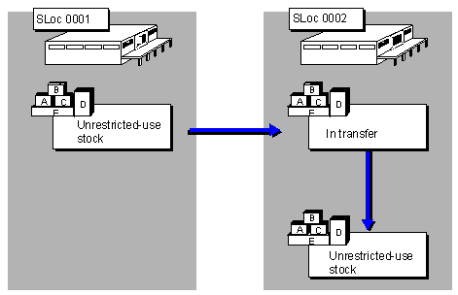
What is a storage location?
Notes:
When saving anything on a computer, it may ask you for a storage location, which is the area where you would like to save the information.
By default, most information is saved to your computer hard drive. If you want to move the information to another computer, save it to a removable storage device such as a flash drive.

Slide 15
Thank you for your attention

